Slide 1
Todo Application
Internship Project
Developed By: Jayashri Shewale
Organization: Naviotech Pvt Ltd.
Description:This project is a full-stack Todo application that helps users manage their daily tasks efficiently with a simple and interactive interface.

Slide 2
Introduction
Todo Application is a web-based task management system
Users can add, edit, delete, and mark tasks as complete
Designed with a clean and user-friendly interface
Demonstrates practical knowledge of frontend and backend integration

Slide 3
Project Objective
Develop a fully functional CRUD (Create, Read, Update, Delete) application.
Learn frontend-backend communication using REST APIs.
Understand how to persist data using MongoDB.
Enhance skills in Vanilla JavaScript and Node.js.
Gain experience in building real-world web applications.

Slide 4
Technology Used
Frontend:
HTML – structure of web pages.
CSS – styling and layout.
JavaScript – dynamic functionality, DOM manipulation.
Backend:
Node.js – server-side JavaScript runtime.
Express.js – framework to handle HTTP requests.
Database:
MongoDB – stores tasks for persistence and retrieval.

Slide 5
Features Implemented
Add Task : Users can add new tasks which get stored in MongoDB.
Edit Task : Update task details after adding.
Delete Task : Remove unnecessary tasks.
Mark as Complete : Toggle task status to completed.
Fetch Tasks : Display all tasks dynamically on the page.
Update Tasks : Tasks update in real-time without refreshing the page.

Slide 6
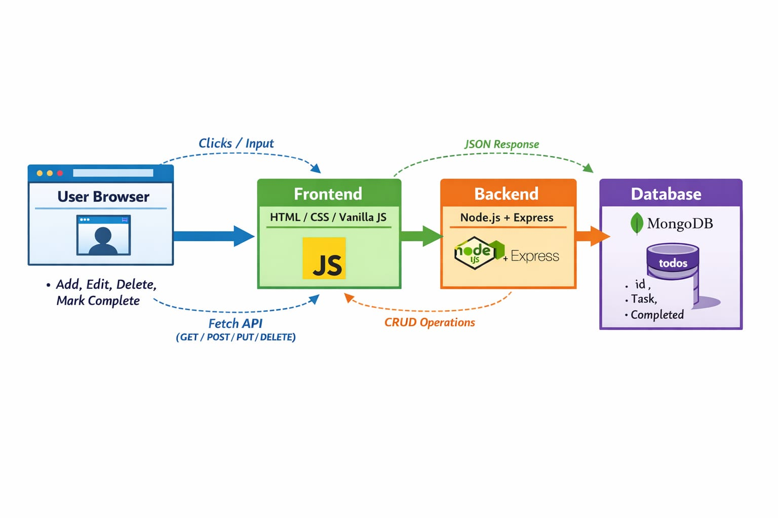
System Architecture

Slide 7
API Endpoints
Method | Endpoint | Functionality
GET | /todos | Fetch all tasks.
POST | /todos | Add a new task.
PUT | /todos/:id | Edit or mark task complete.
DELETE | /todos/:id | Delete a task.
Each task has a unique ID in MongoDB.
PUT method allows update operations, including marking as complete.

Slide 8
User Interaction Flow
Open application → tasks fetched from backend.
Add task → task appears immediately in list.
Edit task → task text updates in DB and UI.
Mark task complete → text is struck through.
Delete task → task removed from DB and UI.
UX Focus:
Dynamic updates
Immediate feedback
Minimal clicks for operations

Slide 9
Learning Outcomes
Learned full-stack development concepts.
Implemented RESTful APIs.
Hands-on experience with CRUD operations.
Understood frontend-backend integration.
Improved problem-solving and debugging skills.
Experience in project workflow and GitHub usage.

Slide 10
Conclusion
All project requirements implemented successfully.
Full-stack knowledge gained with practical experience.
Application ready for real-world use.
Demonstrates ability to manage tasks effectively

Slide 11
Thank You !!!

